Slide 1
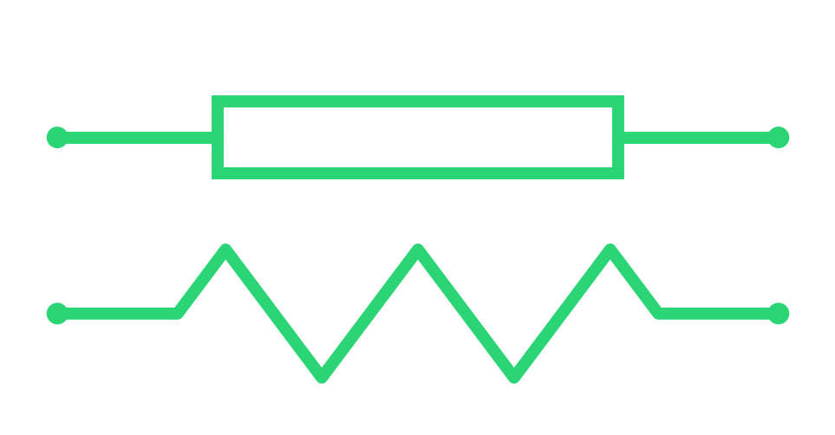
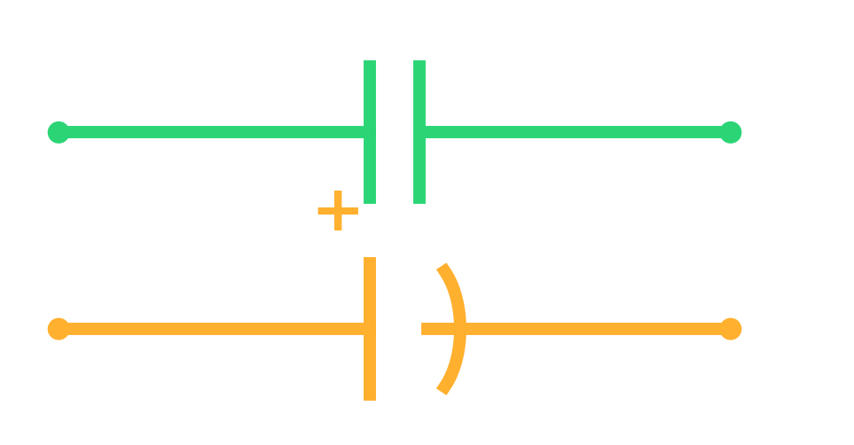
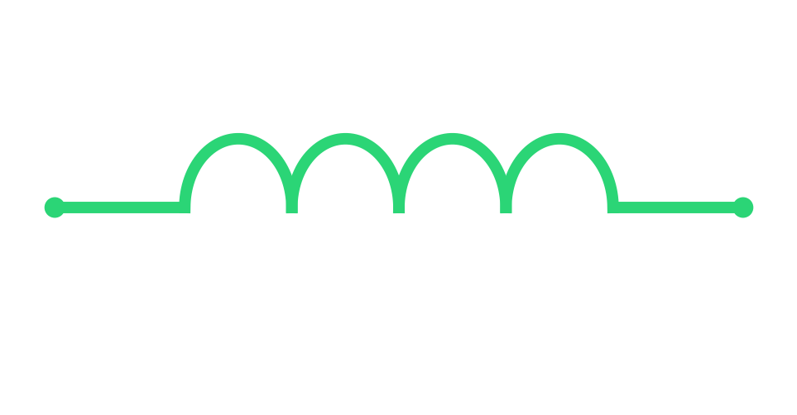
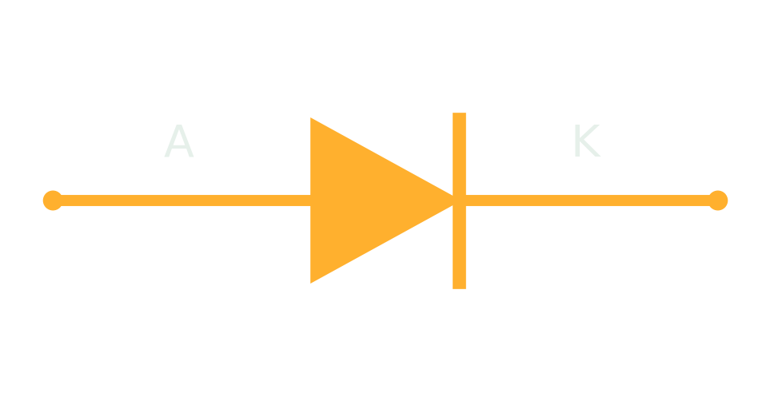
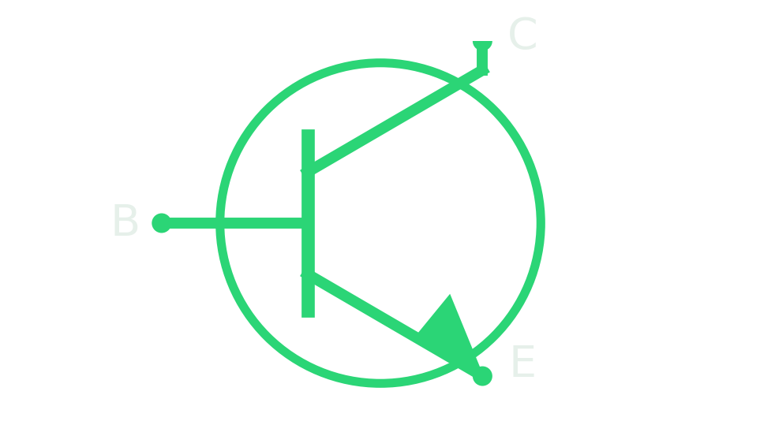
MOD·00
FOUNDATIONS MODULE
Basic Electronic
Components
The five parts you'll meet on every repair bench — what each does, how to spot it, and how to test it.
RESISTOR
CAPACITOR
INDUCTOR
DIODE
TRANSISTOR

Slide 2
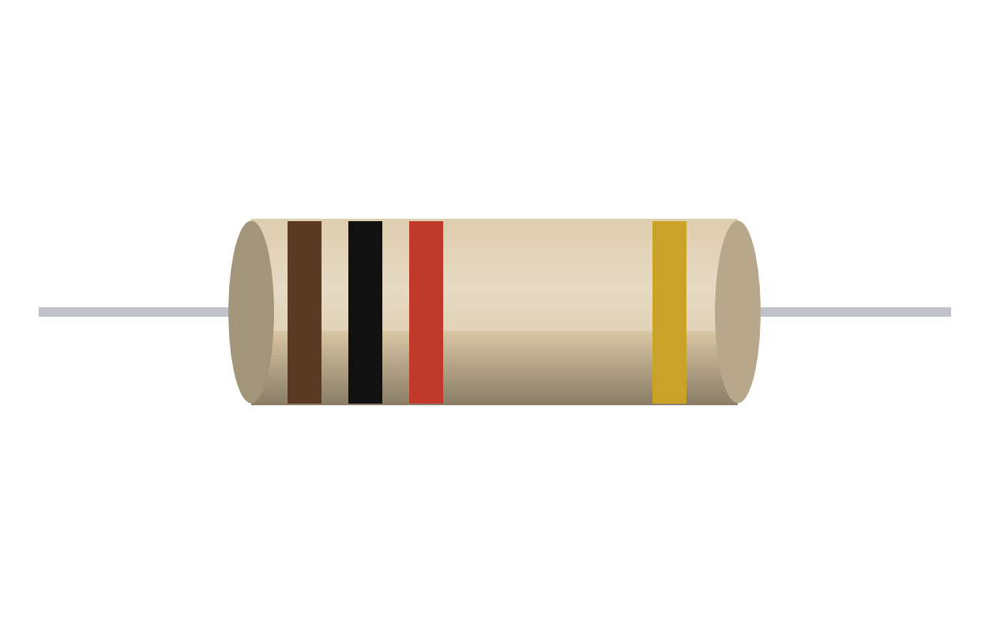
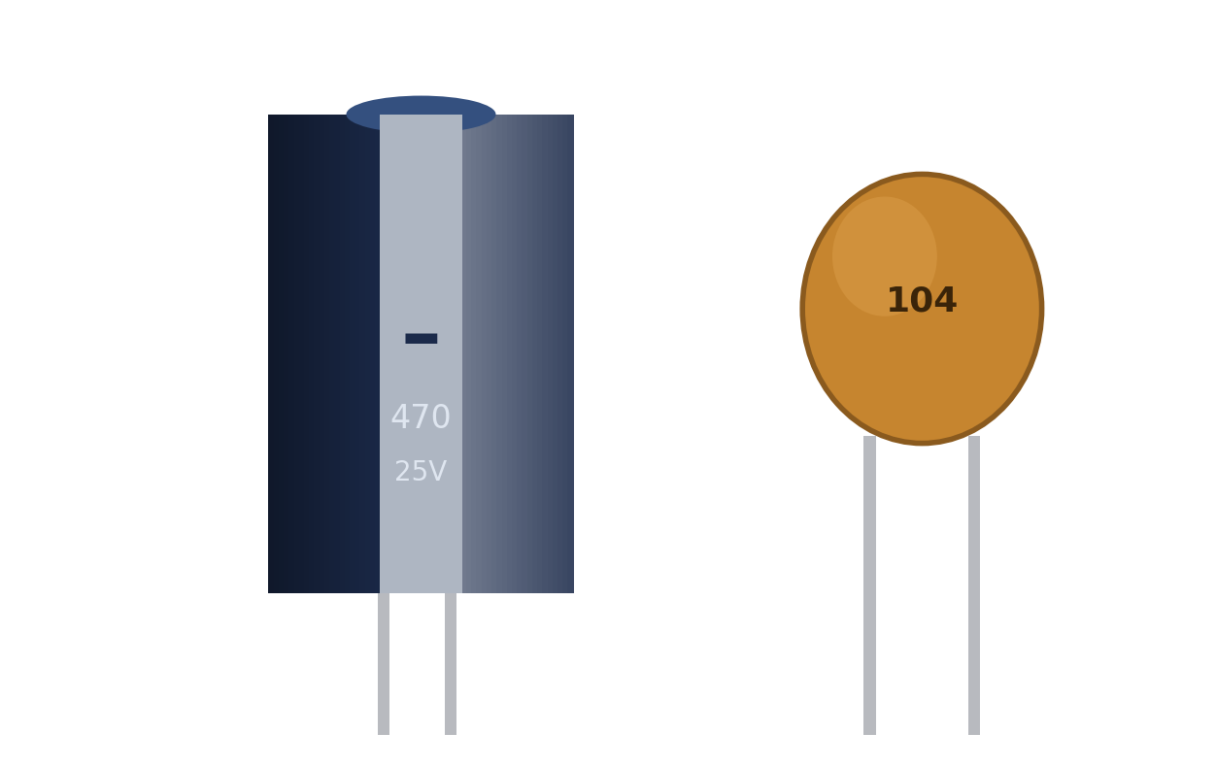
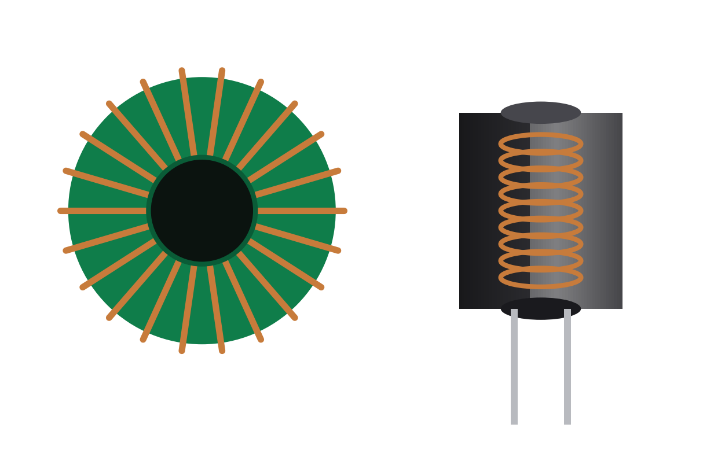
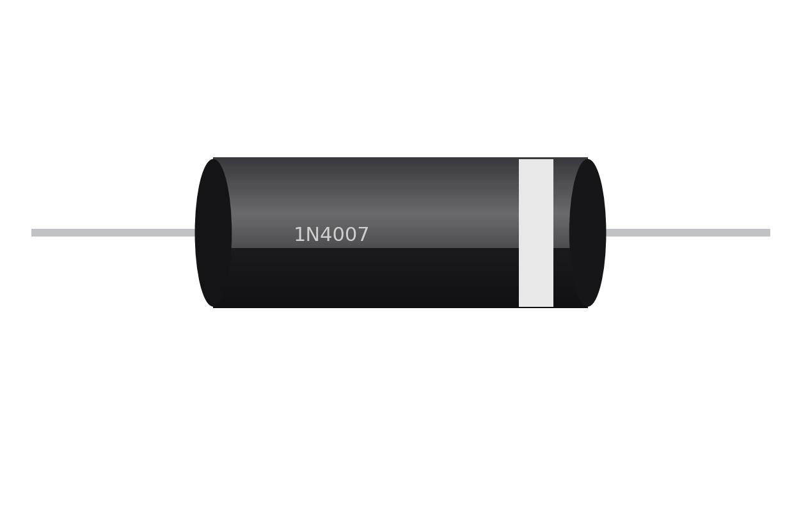
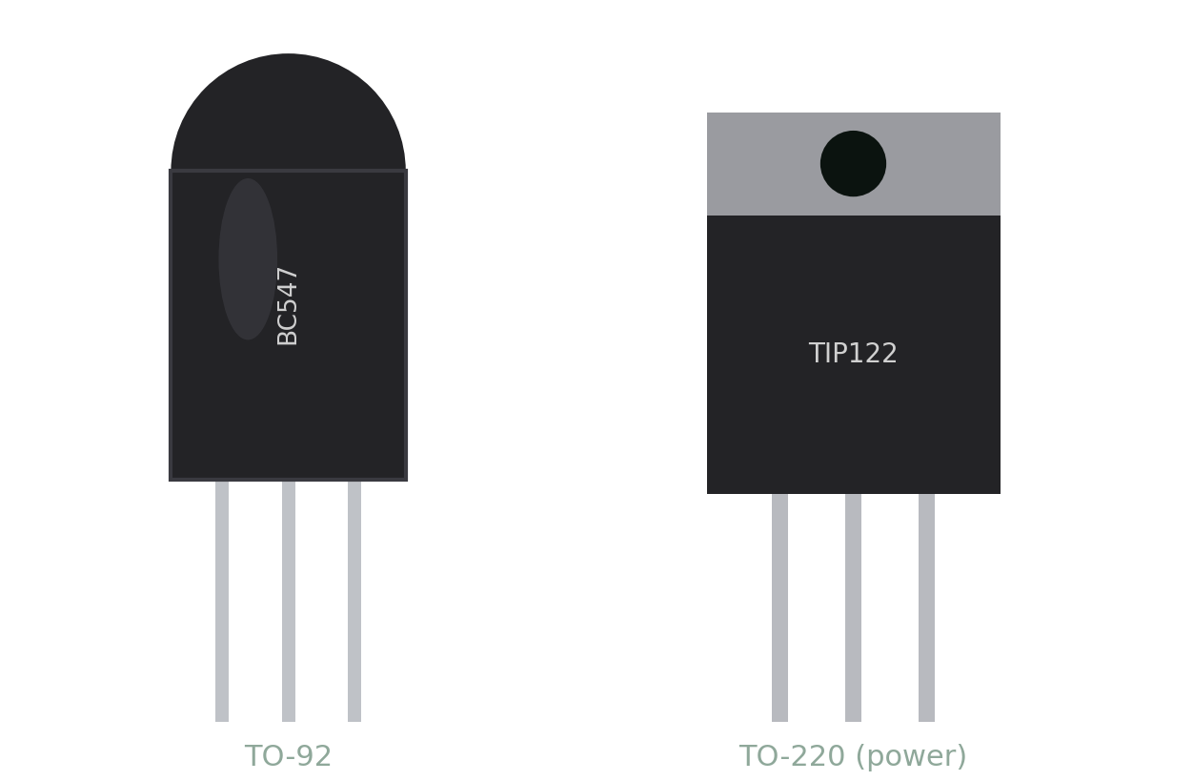
MOD·00
FOUNDATIONS · OVERVIEW
The Five Building Blocks
Every circuit you'll ever repair is built from these five parts.
Resistor
Capacitor
Inductor
Diode
Transistor
Limits current
Stores charge
Stores energy
One-way valve
Switch / amplify
Ohms (Ω)
Farads (F)
Henrys (H)
Vf (V)
Gain (hFE)

Slide 3
MOD·01
FOUNDATIONS · RESISTOR
What Is a Resistor?
A tiny part that pushes back against electric current — on purpose.
In Plain Terms
A resistor limits how much current can flow. More resistance means less current gets through.
Real-World Picture
Like a narrow section in a water pipe — it slows the flow without stopping it.
Key Facts
Schematic symbol
Passive part · fits either way (no polarity) · measured in ohms (Ω).

Slide 4
MOD·01
FOUNDATIONS · RESISTOR
What a Resistor Does
Without one, most circuits would let too much current through — and burn out.
Protects parts
1
Limits current into LEDs and delicate chips
Sets voltage
2
Two resistors in series make a voltage divider
Controls behaviour
3
Brightness, motor speed, or volume
Pull-up / pull-down
4
Through-hole, SMD and variable types
Holds a signal line steady HIGH or LOW

Slide 5
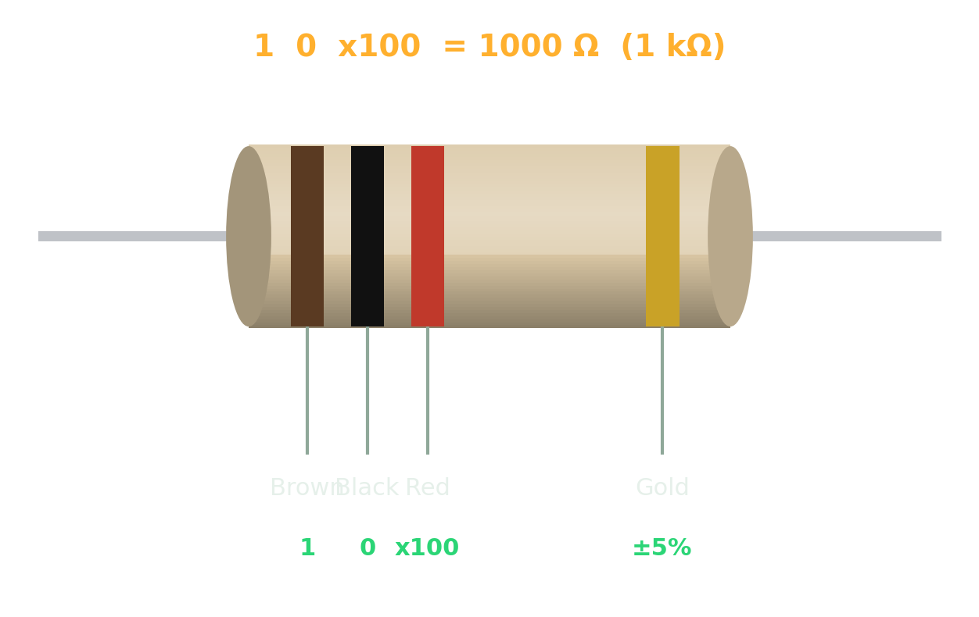
MOD·01
FOUNDATIONS · RESISTOR
Spot It & Read Its Value
The colour bands — or a printed code — tell you the value at a glance.
Through-hole
4 colour bands = 2 digits + a multiplier + tolerance. Read from the band nearest an end.
SMD chip
A printed number: 103 means 10 then 3 zeros = 10 000 Ω (10 kΩ).
Power rating
A bigger body handles more watts — 1/4 W is the everyday size.
Brown-Black-Red-Gold = 1 kΩ ±5%

Slide 6
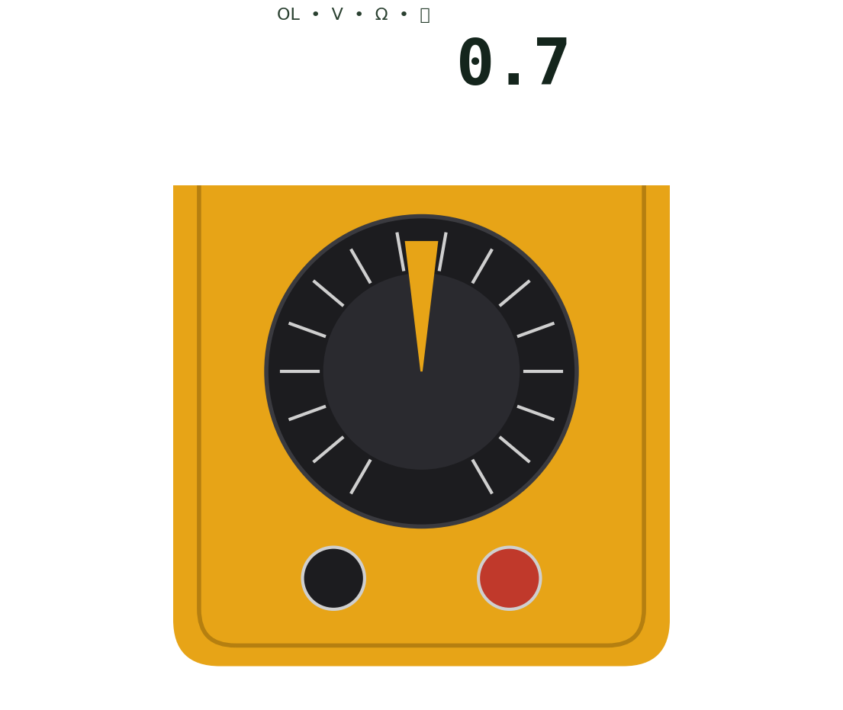
MOD·01
FOUNDATIONS · RESISTOR
Test It on the Bench
One meter setting tells you whether a resistor is still good.
HOW TO TEST
1
Power OFF; measure best out-of-circuit
2
Set the meter to Ω (resistance)
3
Touch one probe to each lead — either way
4
Reading should match the marked value
FAILURE SIGNS
!
Reads open / OL (∞) → burnt or cracked
!
Charred or discoloured body → overheated
!
Value drifted far high → out of spec
Digital multimeter — your first tool

Slide 7
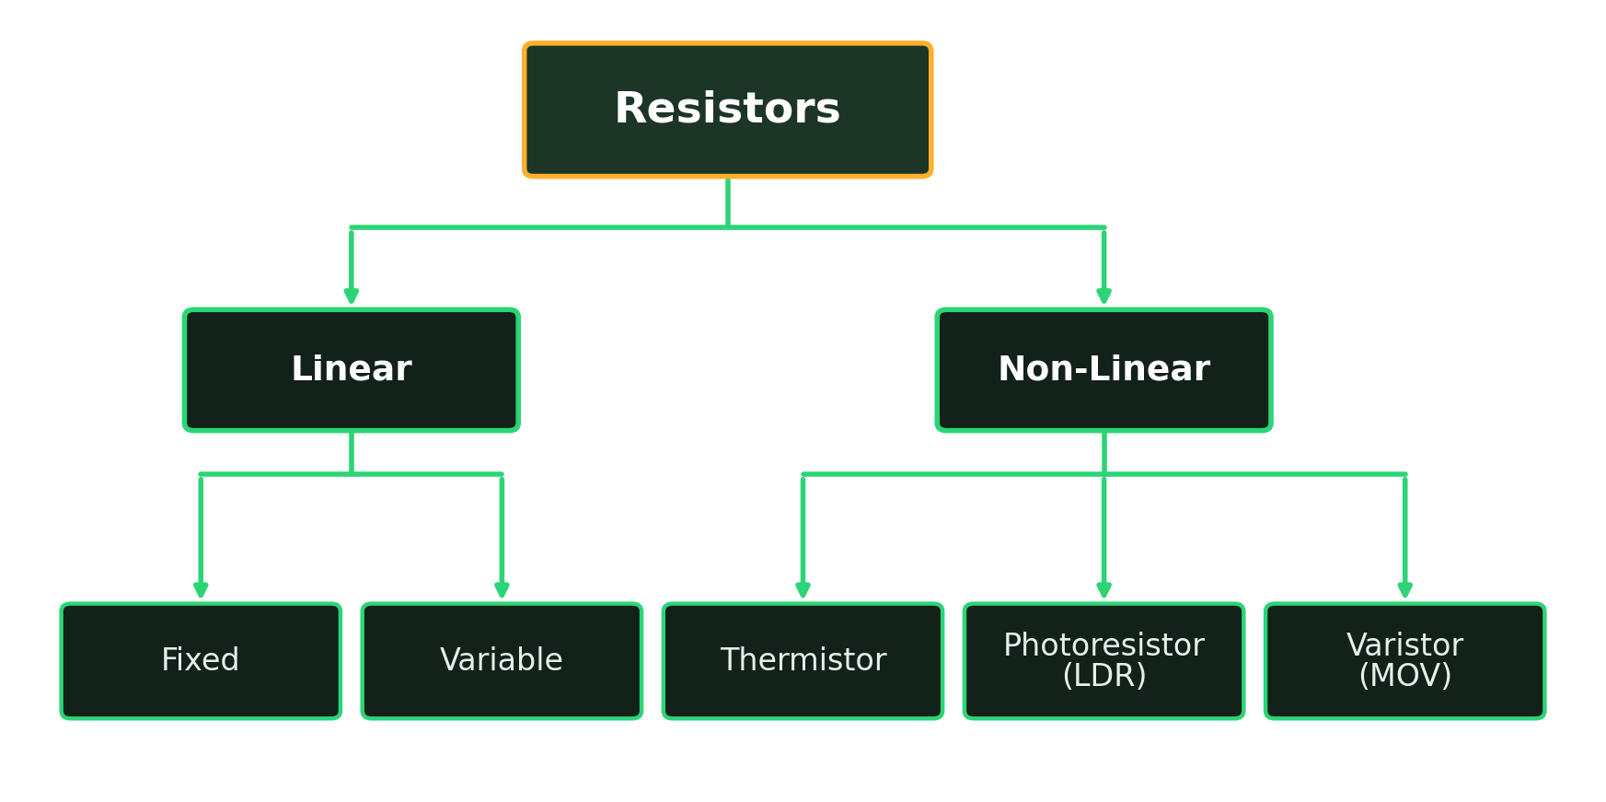
MOD·01
FOUNDATIONS · RESISTOR
Types of Resistor
How resistors are classified — and what each branch means.
HOW IT SPLITS Linear obeys Ohm's law — R stays constant. Non-Linear changes R with heat, light or voltage.

Slide 8
MOD·01
FOUNDATIONS · RESISTOR
Resistor Types — Build, Purpose & Use
What each type is made of, what it's for, and where you'll meet it.
TYPE
HOW IT'S BUILT
PURPOSE
EXAMPLE USE
Fixed
Film or wirewound on a ceramic rod; also SMD chips
One set value
Current limiting, biasing, pull-ups
Variable
A wiper sliding on a resistive track
User-adjustable R
Volume & brightness knobs, trimmers
Thermistor
Metal-oxide bead; R changes with heat
Sense temperature
Inrush limiting, temperature probes
Photoresistor
CdS film; R falls as light rises
Sense light level
Auto night-lights, dusk switches
Varistor
Zinc-oxide grains; R drops above a set V
Clamp voltage surges
Mains surge protection

Slide 9
MOD·02
FOUNDATIONS · CAPACITOR
What Is a Capacitor?
A tiny tank that stores electric charge — and gives it back fast.
In Plain Terms
Stores charge on two plates split by an insulator; it charges and discharges very quickly.
Real-World Picture
A small water tank — it fills up, then empties on demand.
Key Facts
Schematic symbol
Measured in farads (F) — real parts in µF, nF, pF. Electrolytics are polarized: + and − matter!

Slide 10
MOD·02
FOUNDATIONS · CAPACITOR
What a Capacitor Does
The busiest part on any power board — it stores, smooths, and steadies.
Smooths power
1
Flattens bumpy DC after the rectifier
Blocks DC, passes AC
2
Couples a signal between two stages
Decoupling
3
A local energy reserve beside each chip
Timing
4
Electrolytic, ceramic and film types
With a resistor, sets delays and speeds (RC)

Slide 11
MOD·02
FOUNDATIONS · CAPACITOR
Spot It & Read Its Value
Read the printed value — and never ignore the voltage rating or polarity.
Electrolytic
Value + voltage printed (470 µF 25 V). A stripe marks the negative (−) leg.
Ceramic disc
A 3-digit code: 104 = 10 then 4 zeros pF = 100 nF.
Always check
The voltage rating, and — for electrolytics — the polarity.
470 µF 25 V electrolytic · 104 ceramic

Slide 12
MOD·02
FOUNDATIONS · CAPACITOR
Test It on the Bench
Bulging caps are the number-one cause of dead power supplies.
HOW TO TEST
1
DISCHARGE the cap first — it can shock you
2
Set the meter to capacitance mode
3
Compare the reading to the printed µF
4
An ESR meter checks caps in-circuit
FAILURE SIGNS
!
Bulging or vented top → replace
!
Leaked or crusty electrolyte → replace
!
Reads open or way low → worn out
Digital multimeter — your first tool

Slide 13
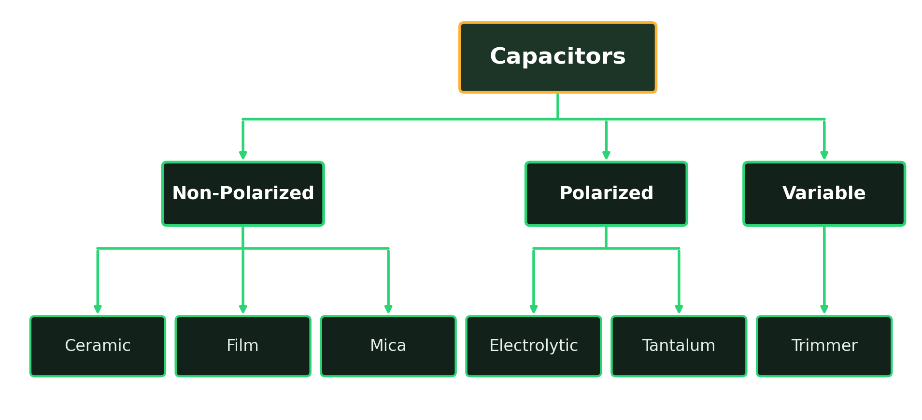
MOD·02
FOUNDATIONS · CAPACITOR
Types of Capacitor
How capacitors are classified — and what each branch means.
HOW IT SPLITS Grouped by dielectric and polarity — polarised types must go in the right way round.

Slide 14
MOD·02
FOUNDATIONS · CAPACITOR
Capacitor Types — Build, Purpose & Use
What each type is made of, what it's for, and where you'll meet it.
TYPE
HOW IT'S BUILT
PURPOSE
EXAMPLE USE
Ceramic
Ceramic dielectric in stacked layers; non-polar
Small value, high frequency
Decoupling & filtering beside ICs
Film
Plastic-film dielectric; stable, non-polar
Accurate mid-range values
Audio, timing, snubbers
Electrolytic
Etched foil + wet electrolyte; polarised
Bulk energy storage
PSU smoothing / reservoir
Tantalum
Tantalum powder + oxide; polarised, compact
High value, small size
Rail decoupling on tight boards
Variable
Overlapping plates moved by a screw
Set-once fine tuning
RF tuning, oscillator trim

Slide 15
MOD·03
FOUNDATIONS · INDUCTOR
What Is an Inductor?
A coil of wire that stores energy in a magnetic field.
In Plain Terms
Current through the coil builds a magnetic field; it resists sudden changes in current.
Real-World Picture
A heavy flywheel — hard to get spinning, and hard to stop once it is.
Key Facts
Schematic symbol
Measured in henrys (H) — real parts in µH, mH · no polarity · just a coil on a core.

Slide 16
MOD·03
FOUNDATIONS · INDUCTOR
What an Inductor Does
Quietly essential — it shapes current and stores energy between switches.
Smooths current
1
With a capacitor, forms an LC filter
Stores energy
2
The heart of switch-mode supplies (buck/boost)
Blocks noise
3
Ferrite beads and chokes kill high-freq hash
Building block
4
Toroid and drum-core types
Of transformers, motors and relays

Slide 17
MOD·03
FOUNDATIONS · INDUCTOR
Spot It & Read Its Value
It hides in plain sight — sometimes it even looks like a resistor.
Shapes
A colour-banded axial part, a drum wound with copper, or a ring (toroid).
Value
Given in µH / mH; some use a number code like resistors.
Current handling
Thicker wire and a bigger core = more current.
Toroid (left) · drum choke (right)

Slide 18
MOD·03
FOUNDATIONS · INDUCTOR
Test It on the Bench
A coil is nearly a plain wire — so a good one barely resists at all.
HOW TO TEST
1
Set the meter to Ω (resistance)
2
A healthy coil reads very LOW Ω
3
Open / OL (∞) means a broken winding
4
An LCR meter reads true inductance
FAILURE SIGNS
!
Open / OL → broken winding, replace
!
Burnt varnish or smell → overheated
!
Cracked ferrite core → damaged
Digital multimeter — your first tool

Slide 19
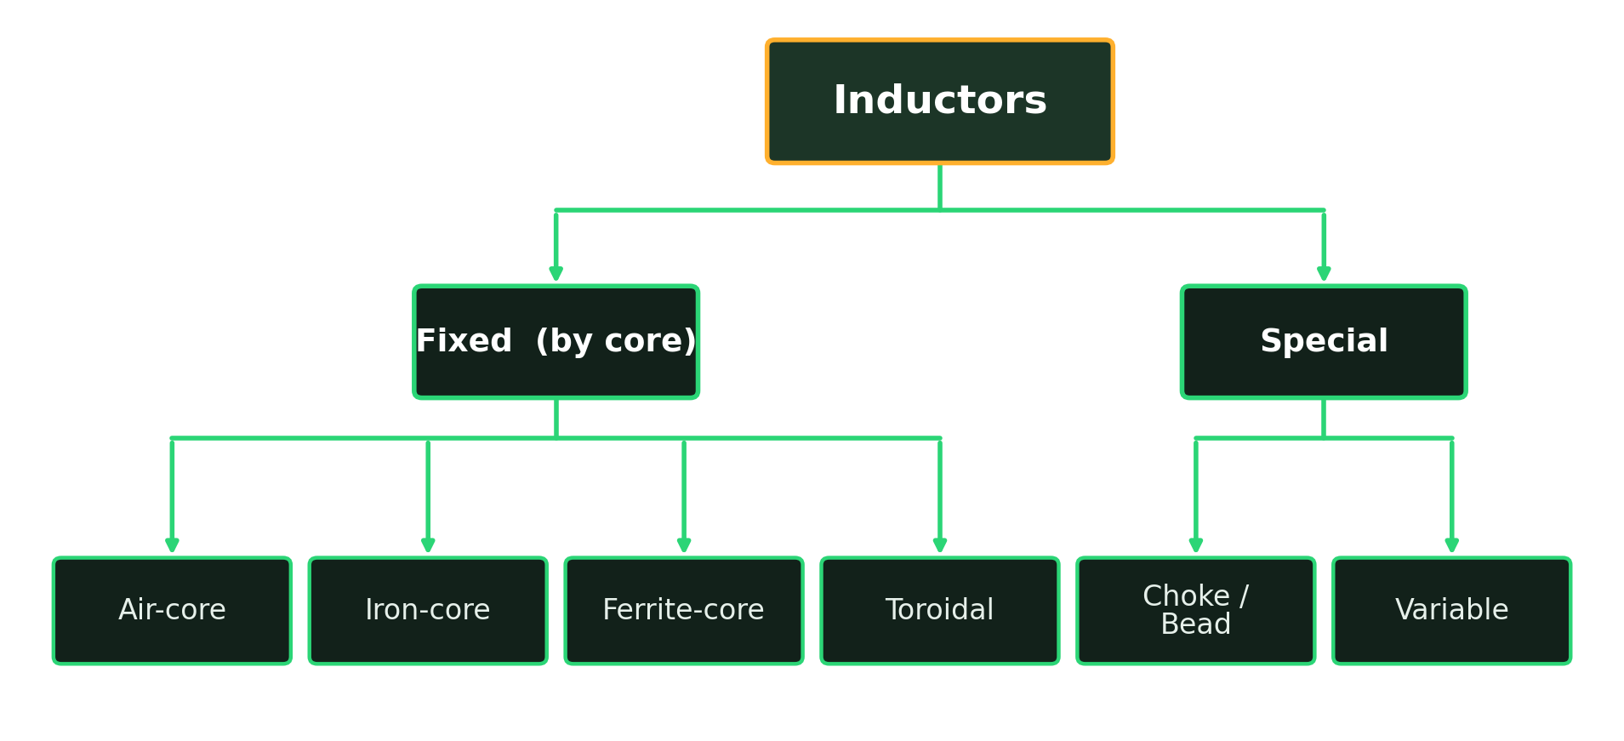
MOD·03
FOUNDATIONS · INDUCTOR
Types of Inductor
How inductors are classified — and what each branch means.
HOW IT SPLITS Grouped mainly by core material, which sets how much energy they store and at what frequency.

Slide 20
MOD·03
FOUNDATIONS · INDUCTOR
Inductor Types — Build, Purpose & Use
What each type is made of, what it's for, and where you'll meet it.
TYPE
HOW IT'S BUILT
PURPOSE
EXAMPLE USE
Air-core
Coil wound with no magnetic core
Low L, no core loss
RF tuning, high-freq filters
Iron-core
Coil on a laminated iron core
Large L at low frequency
Mains transformers, chokes
Ferrite-core
Coil on a ceramic ferrite core
Efficient at high frequency
SMPS, EMI filtering
Toroidal
Wire wound on a ring-shaped core
Low leakage, compact
Power supplies, audio
Choke / Bead
Ferrite slipped over a wire or lead
Block high-freq noise
Cable & rail noise suppression
Variable
Coil with a movable core
Tunable inductance
RF & radio tuning stages

Slide 21
MOD·04
FOUNDATIONS · DIODE
What Is a Diode?
A one-way valve for electric current.
In Plain Terms
Lets current flow one way (anode → cathode) and blocks the other. Needs ~0.7 V to start.
Real-World Picture
A turnstile — it only lets people through in one direction.
Key Facts
Schematic symbol
Has polarity — a stripe marks the cathode (−). Silicon drop ≈ 0.7 V; Schottky ≈ 0.3 V.

Slide 22
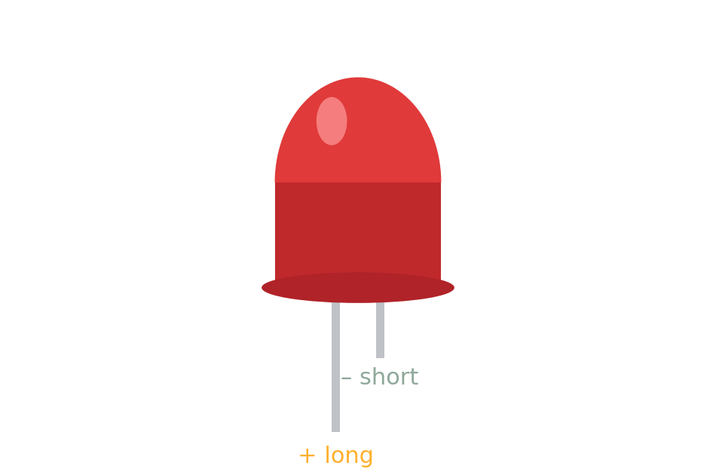
MOD·04
FOUNDATIONS · DIODE
What a Diode Does
The same one-way trick powers four very different jobs.
Rectifies
1
Turns AC into DC (bridge rectifier)
Protects
2
Blocks reverse polarity; clamps voltage spikes
Emits light
3
An LED lights when forward-biased
References voltage
4
An LED is a diode that glows
A Zener holds a steady reference

Slide 23
MOD·04
FOUNDATIONS · DIODE
Spot It & Read It
The stripe and the part number tell you everything you need.
The stripe
Marks the cathode (−) end — current exits here.
Part number
1N4001–1N4007 = mains rectifiers; 1N4148 = fast signal.
LED legs
The longer leg is the anode (+); the flat side is the cathode.
1N4007 rectifier — stripe = cathode

Slide 24
MOD·04
FOUNDATIONS · DIODE
Test It on the Bench
Diode mode reads the junction directly — a 10-second check.
HOW TO TEST
1
Set the meter to DIODE mode
2
Red on anode, black on cathode
3
Good: reads ≈ 0.5–0.7 V one way
4
Swap the probes: should read OL
FAILURE SIGNS
!
Short (≈0 both ways) → blown
!
Open (OL both ways) → blown
!
Very common power-supply failure
Digital multimeter — your first tool

Slide 25
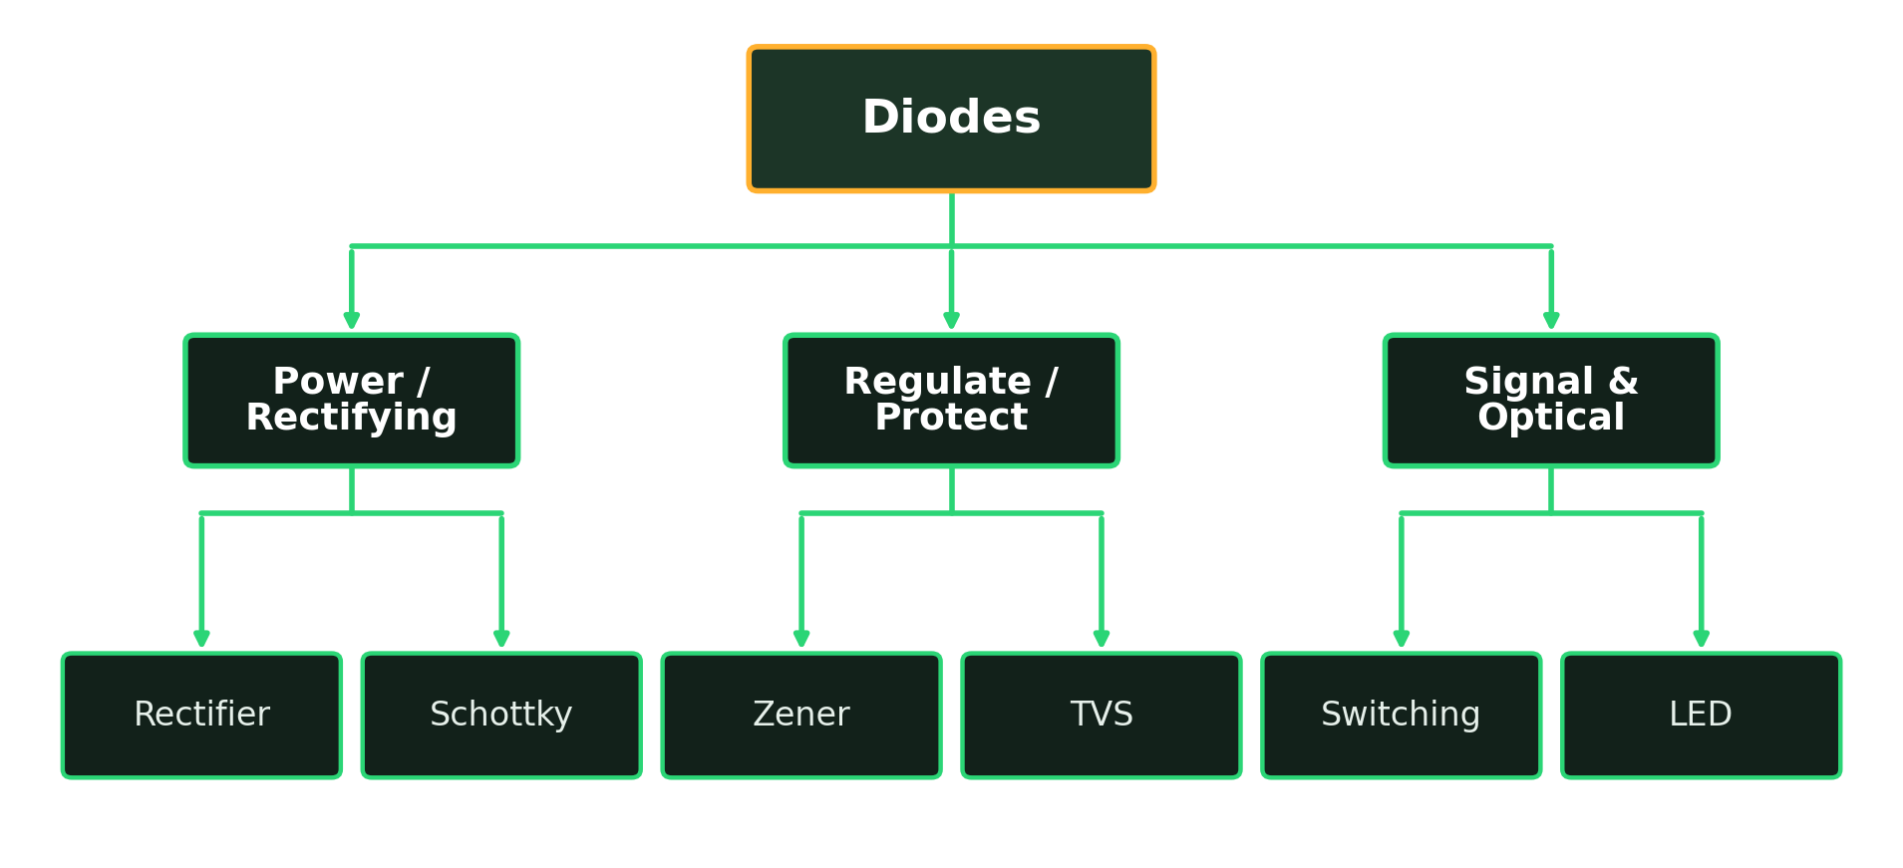
MOD·04
FOUNDATIONS · DIODE
Types of Diode
How diodes are classified — and what each branch means.
HOW IT SPLITS All share the one-way PN junction — the type sets speed, voltage drop and what it protects.

Slide 26
MOD·04
FOUNDATIONS · DIODE
Diode Types — Build, Purpose & Use
What each type is made of, what it's for, and where you'll meet it.
TYPE
HOW IT'S BUILT
PURPOSE
EXAMPLE USE
Rectifier
Large silicon PN junction
AC to DC at high current
PSU bridge (1N4007)
Schottky
Metal-to-semiconductor junction
Low drop, very fast
SMPS, reverse-polarity guard
Zener
Doped junction run in reverse
Hold a fixed voltage
Voltage reference / clamp
Switching
Small, fast PN junction
Fast low-current on/off
Logic & signal (1N4148)
LED
Compound junction that emits light
Indicate / illuminate
Indicators, displays, lighting
TVS
Rugged junction that clamps fast
Absorb transient spikes
Port & ESD protection

Slide 27
MOD·05
FOUNDATIONS · TRANSISTOR
What Is a Transistor?
An electrically-controlled switch and amplifier.
In Plain Terms
A small current or voltage on one leg controls a much bigger current through the other two.
Real-World Picture
A tap where a light touch controls a big flow of water.
Key Facts
Schematic symbol
Three legs — BJT: Base, Collector, Emitter; MOSFET: Gate, Drain, Source. The building block of every chip.

Slide 28
MOD·05
FOUNDATIONS · TRANSISTOR
What a Transistor Does
Two simple jobs that add up to all of modern electronics.
Switching
1
Turn motors, relays and LEDs on/off from a tiny signal
Amplifying
2
Make weak signals — like audio — stronger
BJT family
3
Controlled by a small base current
MOSFET family
4
TO-92 small-signal · TO-220 power
Controlled by gate voltage; runs power & logic

Slide 29
MOD·05
FOUNDATIONS · TRANSISTOR
Spot It & Read It
The package and the printed number reveal what you're holding.
Part number
BC547, 2N2222 (small signal); TIP122, IRFZ44N (power).
Package = power
TO-92 is small-signal; TO-220 with a metal tab is power.
Check the datasheet
Pin order changes by part — always confirm before wiring.
TO-92 (left) · TO-220 power (right)

Slide 30
MOD·05
FOUNDATIONS · TRANSISTOR
Test It on the Bench
A good BJT behaves like two diodes joined back-to-back at the base.
HOW TO TEST
1
Set the meter to DIODE mode
2
Base→Emitter reads ≈0.7 V one way
3
Base→Collector reads ≈0.7 V one way
4
Both read OL with probes reversed
FAILURE SIGNS
!
Collector–Emitter short (≈0) → blown
!
Any junction open both ways → blown
!
Common in switching / power faults
Digital multimeter — your first tool

Slide 31
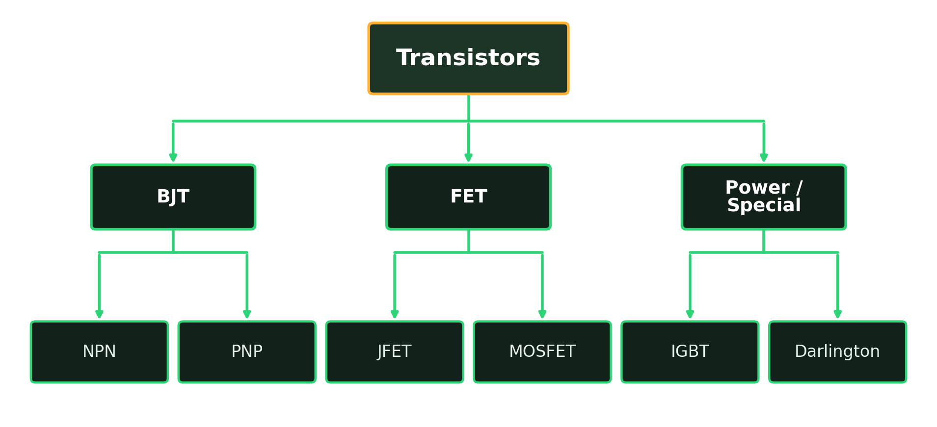
MOD·05
FOUNDATIONS · TRANSISTOR
Types of Transistor
How transistors are classified — and what each branch means.
HOW IT SPLITS Two big families: current-controlled BJTs and voltage-controlled FETs, plus power hybrids.

Slide 32
MOD·05
FOUNDATIONS · TRANSISTOR
Transistor Types — Build, Purpose & Use
What each type is made of, what it's for, and where you'll meet it.
TYPE
HOW IT'S BUILT
PURPOSE
EXAMPLE USE
NPN BJT
N-P-N silicon; current-controlled
Switch/amplify (on with base I)
Low-side switch, audio (BC547)
PNP BJT
P-N-P silicon; current-controlled
High-side switching
Load switch (BC557)
JFET
Channel pinched by gate voltage
High-impedance amplifier
Sensor front-ends, audio
MOSFET
Insulated gate over a channel
Efficient V-controlled switch
SMPS, motor drivers (IRFZ44)
IGBT
MOSFET gate + BJT output stage
Switch high V and current
Inverters, induction heaters
Darlington
Two BJTs cascaded together
Very high current gain
Relay & lamp drivers (TIP122)

Slide 33
MOD·00
REPAIR BENCH · CHEAT SHEET
Quick Test Reference
One line per part — the meter setting, a healthy reading, and a bad one.
COMPONENT
METER SETTING
GOOD READING
BAD READING
Resistor
Ohms (Ω)
= marked value (±tol.)
Open / OL, or way off
Capacitor
Capacitance / ESR
= marked µF, low ESR
Bulged, open or leaky
Inductor
Ohms (Ω)
Very low Ω (near short)
Open / OL
Diode
Diode mode
0.5–0.7 V one way, OL other
Short or open both ways
Transistor
Diode mode
0.7 V B–E & B–C one way
Shorted C–E

Slide 34
LAB·00
HANDS-ON LAB
Build It, Read It, Measure It
Four projects turn the five components into working circuits — and drill the three core bench skills.
R
Read a schematic
THE PROJECT LADDER
Follow symbols, nodes and part labels from paper to board.
LED Indicator
01
Beginner · 30 min R · LED
Solder clean joints
02
555 LED Flasher
S
Sockets first, shiny joints, right order — no cold or bridged pads.
Beginner+ · 1 hr R · C · LED · IC
03
Transistor Relay Driver
Intermediate · 1 hr Q · R · D · coil
M
Measure & verify
Mini DC Power Supply
04
Prove the circuit with a multimeter — volts, current, continuity.
Intermediate · 1.5 hr D · C · coil · R

Slide 35
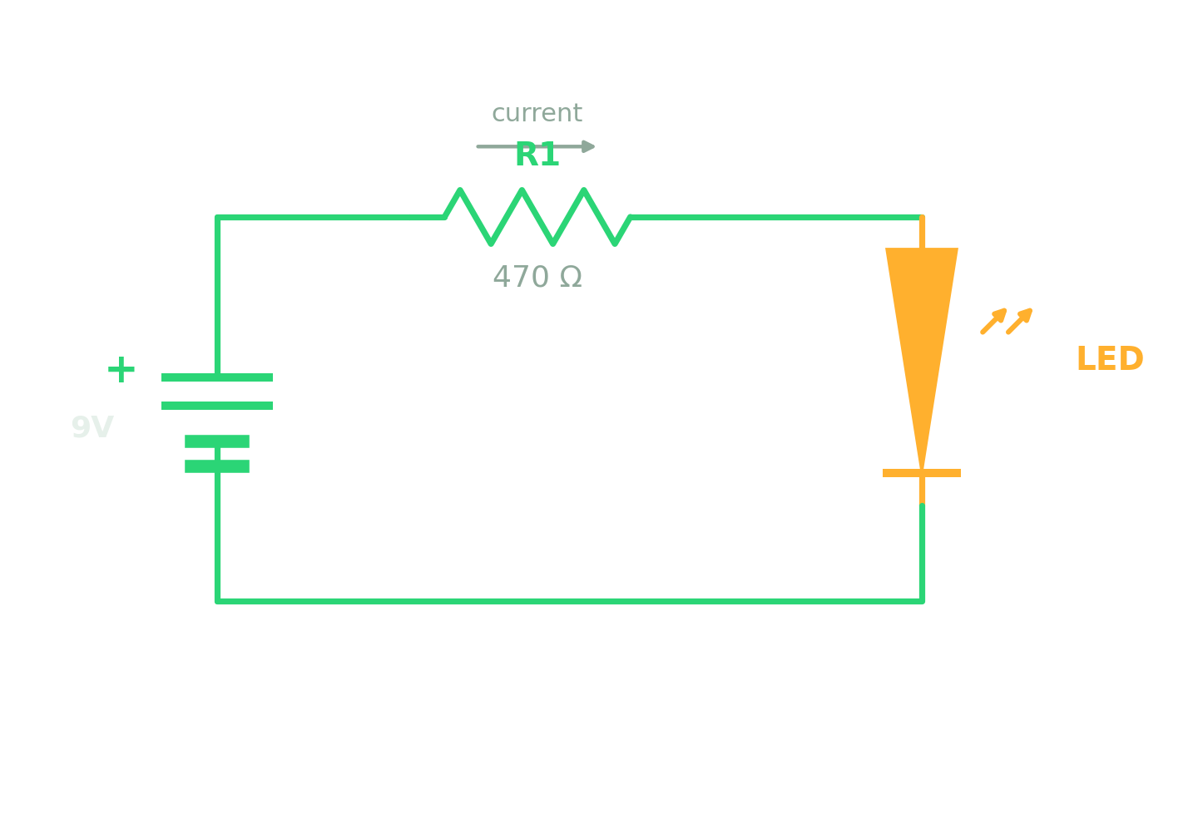
LAB·01
HANDS-ON LAB · PROJECT 01
LED Indicator
The simplest working circuit — a resistor protecting an LED.
BEGINNER · 30 MIN
YOU'LL BUILD
9V battery + clip, 470 Ω resistor, one LED, a piece of perfboard.
BUILD & SOLDER
1 Read the schematic — it's one series loop.
2 Mount R1 and the LED; mind the LED's flat side.
3 Solder each joint shiny, not blobby.
Read the schematic before you solder
MEASURE & VERIFY
COMPONENTS USED
Battery reads ≈ 9 V.
LED forward drop ≈ 2 V.
Current ≈ 15 mA (V across R ÷ 470).
Resistor · LED (diode) · 9V battery

Slide 36
LAB·01
HANDS-ON LAB · PROJECT 01
LED Indicator — Why It Works
Why each part sits where it does, how the value is set, and what breaks if it's gone.
WORKING OUT THE NUMBERS
Voltage left for R1 = 9V − 2V (LED) = 7V
R = V ÷ I = 7V ÷ 0.02A = 350Ω → use next standard 470Ω
Bench check: I = 7V ÷ 470Ω ≈ 15 mA — safe for the LED.
PART
WHY IT'S PLACED HERE
IF MISSING OR BROKEN
R1 470Ω
In series with the LED to cap current to a safe ~15 mA.
Shorted/gone: LED gets full current and burns out. Open: LED dark.
LED
The indicator load; lights only with current flowing the right way.
Reversed or open: dark (0 mA). Shorted: R1 overheats.
9V battery
Sets the loop voltage that R1 and the LED share.
Flat/absent: nothing lights; 0 V around the loop.

Slide 37
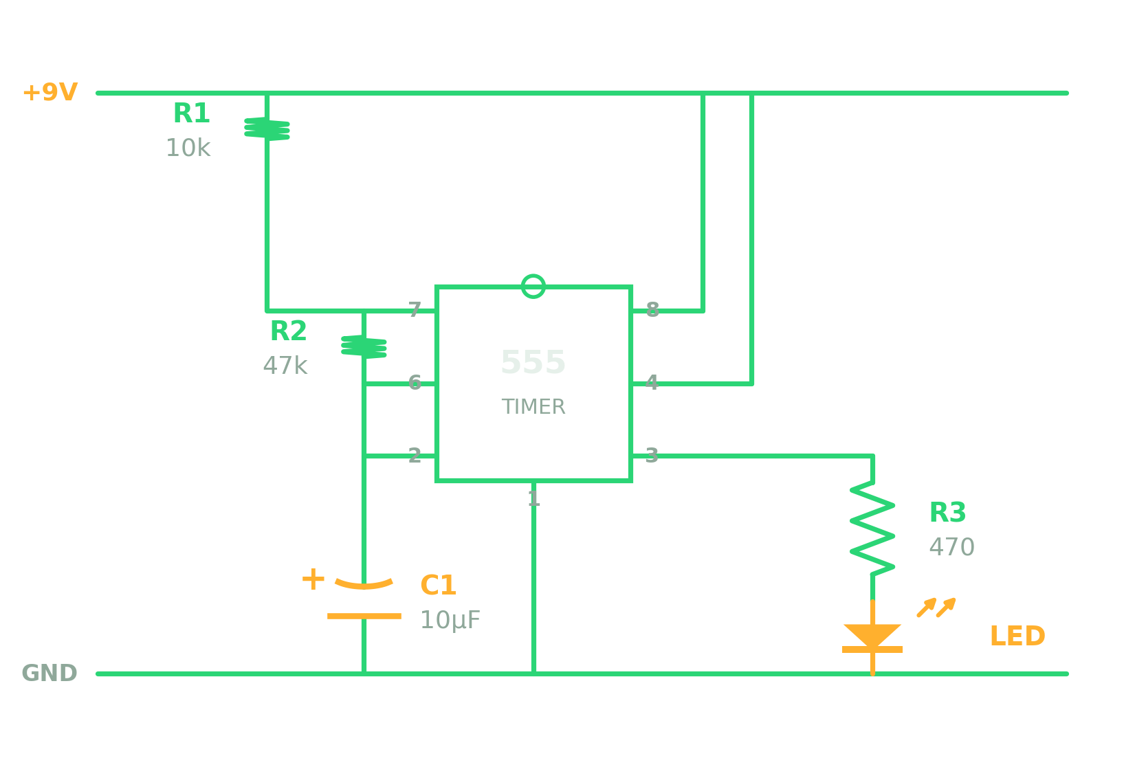
LAB·02
HANDS-ON LAB · PROJECT 02
555 LED Flasher
An IC timer blinks an LED — you set the speed with one R and one C.
BEGINNER+ · 1 HR
YOU'LL BUILD
555 timer + 8-pin socket, R1 10k, R2 47k, C1 10µF, R3 470, LED, 9V.
BUILD & SOLDER
1 Solder the socket first — never the hot IC.
2 Wire R1, R2 and C1 exactly per the schematic.
3 Insert the 555 into the socket last.
Read the schematic before you solder
MEASURE & VERIFY
COMPONENTS USED
Pin 3 output swings 0 ↔ 9 V.
Time the flashes with a stopwatch.
Check f = 1.44 ÷ ((R1+2·R2)·C1).
Resistor · Capacitor · LED · 555 timer IC

Slide 38
LAB·02
HANDS-ON LAB · PROJECT 02
555 LED Flasher — Why It Works
Why the R's and C set the speed, how the frequency is found, and what stalls the flash.
WORKING OUT THE NUMBERS
f = 1.44 ÷ ((R1 + 2·R2)·C1) = 1.44 ÷ (104k · 10µF) ≈ 1.4 Hz
≈ 0.7 s per blink. Verify: time 10 flashes ÷ 10. Bigger R or C = slower flash.
PART
WHY IT'S PLACED HERE
IF MISSING OR BROKEN
R1 + R2
Set C1's charge/discharge path — together they fix the flash rate.
Either open: C1 can't cycle, so the flashing stops.
C1 10µF
Timing tank; swings between ⅓ and ⅔ Vcc every cycle.
Open: output frozen. Shorted: pins 2/6 stuck, no flash.
R3 470Ω
Limits LED current on the 555 output (pin 3).
Missing: LED over-driven and may fail. Open: LED dark.
555 IC
Watches C1's voltage and toggles the output — the 'brain'.
Dead or mis-inserted: no swing at pin 3, LED still.

Slide 39
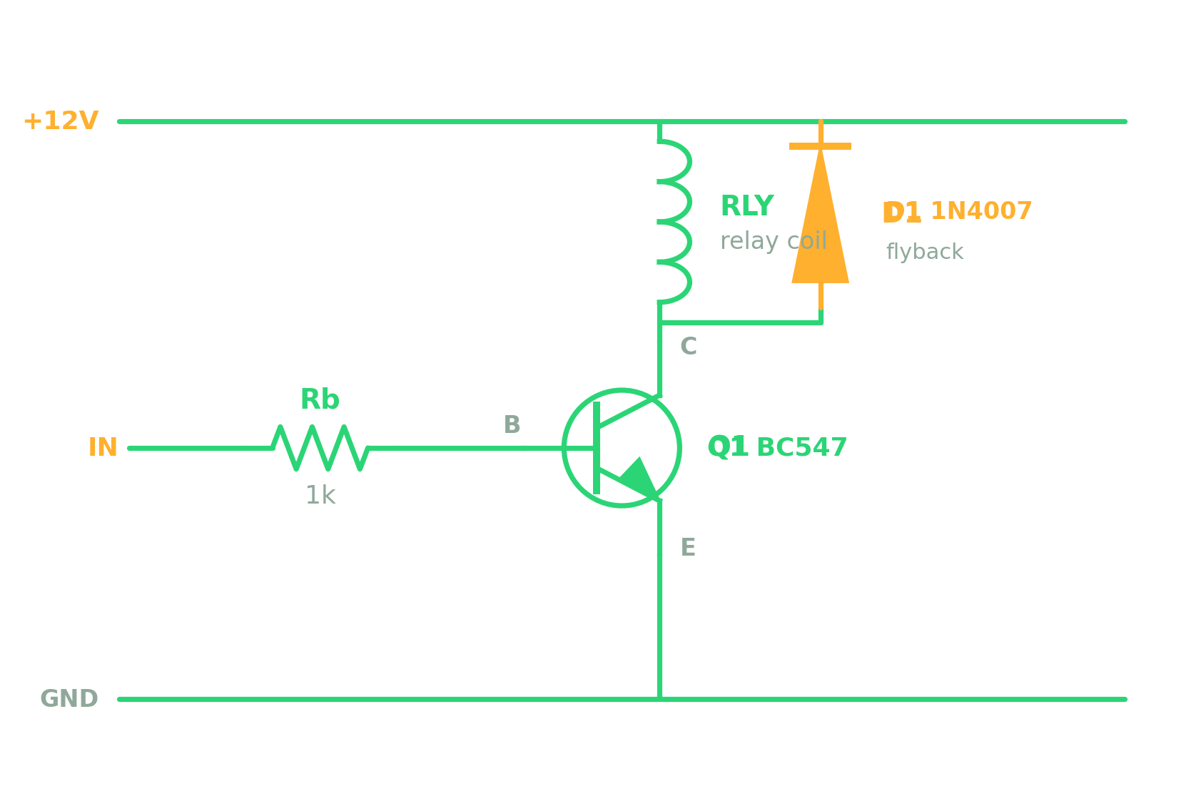
LAB·03
HANDS-ON LAB · PROJECT 03
Transistor Relay Driver
A tiny input current switches a big load — safely.
INTERMEDIATE · 1 HR
YOU'LL BUILD
BC547 transistor, Rb 1k, a 12V relay, 1N4007 flyback diode, 12V supply.
BUILD & SOLDER
1 Solder Rb to the base; emitter to GND.
2 Relay coil from collector up to +12V.
3 Fit D1 across the coil — band to +12V.
Read the schematic before you solder
MEASURE & VERIFY
COMPONENTS USED
Base ≈ 0.7 V when switched ON.
Collector drops near 0 V; relay clicks.
D1 clamps the coil's reverse kick.
Transistor · Resistor · Diode · Inductor (relay coil)

Slide 40
LAB·03
HANDS-ON LAB · PROJECT 03
Transistor Relay Driver — Why It Works
Why the base resistor and flyback diode matter, how ON is proven, and what fails without them.
WORKING OUT THE NUMBERS
I_B = (Vin − 0.7V) ÷ Rb ≈ 4 mA — several× more than needed → Q1 saturates
Verify: base ≈ 0.7V and the collector drops to ~0.2V (Vce-sat) when switched ON.
PART
WHY IT'S PLACED HERE
IF MISSING OR BROKEN
Rb 1k
Feeds just enough base current to drive Q1 fully ON.
Open/too big: Q1 won't switch, runs hot. Too small: base fries.
Q1 BC547
The switch — a tiny base current gates the big coil current.
Shorted C-E: relay stuck on. Open: never energizes.
Relay coil
The inductive load; its magnetic field pulls the contacts.
Open coil: no click; collector sits at +12 V.
D1 1N4007
Sits across the coil to catch the turn-off spike (back-EMF).
Missing: the spike destroys Q1. Backwards: shorts the supply.

Slide 41
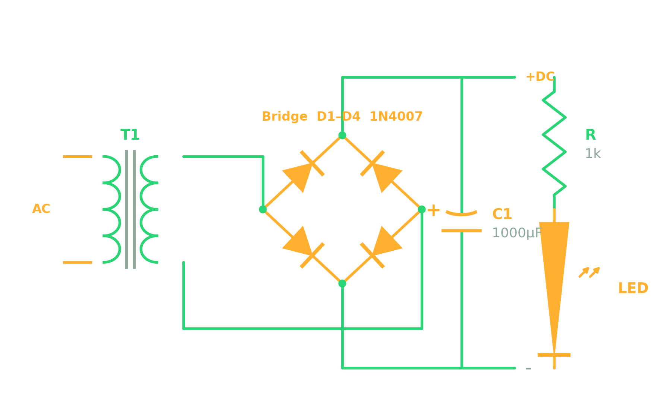
LAB·04
HANDS-ON LAB · PROJECT 04
Mini DC Power Supply
Turn AC into smooth DC — the front end of every adapter.
INTERMEDIATE · 1.5 HR
YOU'LL BUILD
Low-voltage transformer, 4× 1N4007 (bridge), C1 1000µF, R 1k, LED.
BUILD & SOLDER
1 Solder the four-diode bridge.
2 Add C1 — watch its polarity!
3 Fit the indicator LED and R.
Read the schematic before you solder
MEASURE & VERIFY
COMPONENTS USED
Read AC in (VAC), then DC out (VDC).
Watch ripple shrink once C1 is fitted.
⚠ Mains side supervised; discharge C1 after.
Diode · Capacitor · Inductor (transformer) · Resistor

Slide 42
LAB·04
HANDS-ON LAB · PROJECT 04
Mini DC Power Supply — Why It Works
Why each stage exists, how the DC voltage and ripple are estimated, and what each fault does.
WORKING OUT THE NUMBERS
DC out ≈ VAC × 1.414 − 1.4V (two diode drops). 9V AC → ~11–12V DC
Ripple ≈ I_load ÷ (f · C1), with f = 100 Hz for a full-wave bridge
Verify: measure VAC in, then VDC out; watch ripple shrink once C1 is fitted.
PART
WHY IT'S PLACED HERE
IF MISSING OR BROKEN
Transformer
Steps mains down to safe low AC and isolates you from it.
Open: no output. (Mains side — supervised only.)
Bridge 4×D
Flips both halves of the AC the same way → pulsating DC.
One diode open: half-wave, double ripple. One shorted: blows parts.
C1 1000µF
Charges on the peaks and fills the dips → smooth DC.
Open/dried: big ripple returns. Reversed: it vents or explodes.
R + LED
Power-on indicator; R limits the LED current.
R open: LED dark, but the supply still works.

Slide 43
MOD·00
MODULE WRAP-UP
You Can Now…
By the end of this module, every recruit should be able to:
Name all five basic parts and say what each one does
✓
!
Read a resistor's colour code and a capacitor's markings
✓
Recognise real parts on a board — and their schematic symbols
GOLDEN RULE
✓
Power off and discharge capacitors before you probe anything.
Test each part with a multimeter and spot common failures
✓
Build, solder and measure a working circuit from a schematic
✓

